Slide 1
IOT BASED EV BATTERY MANAGEMENT AND PROTECTION SYSTEM THIRD REVIEW Team Members : Purushothamman.M (950021106703) Gopi.R (950021106013) Mohamed Usman.P (950021106022) Javahar.S (950021106015) Guide: Dr. S. Suja Priyadarshini , Asst.Prof ANNA UNIVERSITY REGIONAL CAMPUS TIRUNELVELI.

Slide 2
INTRODUCTION
As the shift toward eco-friendly transportation accelerates, electric vehicles (EVs) are becoming more common—but their batteries need smart care and protection to perform reliably over time.
Our project introduces an IoT-based system that keeps a constant check on the EV battery’s health by monitoring temperature, voltage, and other key parameters in real-time.
With this approach, we aim to prevent breakdowns, improve safety, and make EVs more efficient and user-friendly through early warnings and remote monitoring.

Slide 3

OBJECTIVES
Our aim was to build a system that could monitor the condition of an EV battery using IoT.
We wanted to make the battery smarter by adding automatic safety responses so if something goes wrong, like too much heat or low voltage, the system can protect the Battery
We also focused on helping users take better care of their batteries by giving them early warnings and remote access, so they can fix small problems before they become big ones.

Slide 4
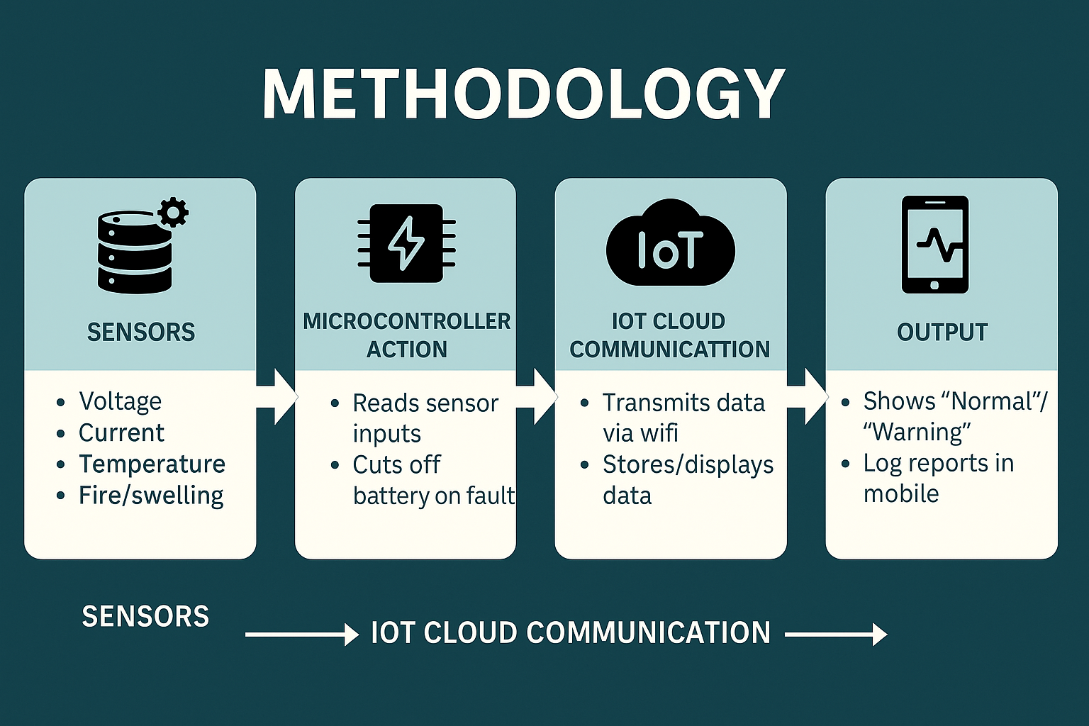
METHODOLOGY
METHODOLOGY:
Sensor Modules (Temperature, Current, Voltage, and Flame) Collect real-time data from the EV Battery and send it to the Arduino UNO for processing.
The System checks for Abnormal Conditions by comparing sensor readings against predefined safety thresholds.
If an anomaly is detected, the relay disconnects the battery and the data is uploaded to the IOT Cloud for remote monitoring and alerting.

Slide 5
LITERATURE SURVEY
S.No | Name, Author Name, Year | Publication | Methodology | Drawbacks
1. | IoT-Based Battery Monitoring System in E-Vehicle Authors: J. Nagendran, R. Vasanth, J. Tamizharasan, P.A. Anas, G. Swathisri Year: 2024 | International Journal of New Innovations in Engineering and Technology | Uses IoT sensors for real-time monitoring of battery voltage, current, and temperature. Data is sent to a cloud server for analysis and display. | No detailed predictive analytics for battery failure prevention.
2. | A Basic Battery Management System Design with IoT Feature for LiFePO4 Batteries Authors: İlker Aydın, Özgür Üstün Year: 2023 | Istanbul Technical University | GSM-based IoT monitoring for charge-discharge control method. | It uses traditional model based methods which is more susceptible to inaccuracies and cumulative errors than data driven approaches.

Slide 6
LITERATURE SURVEY
S.No | Name, Author Name, Year | Publication | Methodology | Drawbacks
3. | Arduino based Battery Management System for EV Vehicles Authors: Samyak Nagrale, Ankit Waghmare, Tanmay Sahare, Achal Nagwanshi, Ishika Sakhale, Dr. Jyoti Sathe Year: 2023 | IJARIIE | Uses an Arduino microcontroller with sensors to monitor battery state-of-charge (SoC) and temperature. Provides alerts for overcharging and overheating. | Limited number of parameters is taken into account.
4. | Battery Management System using SoC Estimation. Authors: Suman Haldar, Supratim Mondal, Arindam Mondal, Rajib Banerjee Year: 2022 | NITMAS, Kolkata | Focuses on SoC estimation using IoT-based real-time wireless battery monitoring. Uses MQTT protocol for cloud-based monitoring. | Limited analysis on real-world scalability for EV fleets.

Slide 7
LITERATURE SURVEY
S.No | Name, Author Name, Year | Publication | Methodology | Drawbacks
5. | Monitoring State of Health and State of Charge of Lithium-Ion Batteries Using Machine Learning Techniques Authors: A. Varshney, A. Singh, A. A. Pradeep, A. Joseph, P. Gopakumar Year: 2021 | IEEE 5th International Conference on Condition Assessment Techniques in Electrical Systems (CATCON) | Adopted machine learning techniques for battery SoC and state-of-health (SoH) monitoring. | Requires high quality datasets and prone biased data.
6. | Deep Learning Enabled State-of-Charge Estimation of LiFePO4 Batteries: A Systematic Validation on State-of-the-Art Charging Protocols Authors: C. Hu, L. Ma, S. Guo, G. Guo, Z. Han Year: 2022 | Energy | Validated deep learning models for estimating SoC under various charging protocols. | Computational complexities Which requires lightweight model deployment.

Slide 8
LITERATURE SURVEY
S.No | Name, Author Name, Year | Publication | Methodology | Drawbacks
7 | Compensation Method for Estimating the State of Charge of Li-Polymer Batteries Using Multiple Long Short-Term Memory Networks Based on the Extended Kalman Filter Authors: D. Shin, B. Yoon, S. Yoo Year: 2021 | Energies | Proposed a method combining multiple LSTM networks and the Extended Kalman Filter for state-of-charge (SoC) estimation. | Heavyweight model not have suitable compatibility in BMS system.
8 | Battery State-of-Charge Estimation Amid Dynamic Usage with Physics-Informed Deep Learning Authors: J. Tian, R. Xiong, J. Lu, C. Chen, W. Shen Year: 2022 | Energy Storage Materials | Leveraged physics-informed deep learning for dynamic battery SoC estimation. | Difficulties in accurately modelling dyanamic behaviours of battery.

Slide 9
MODULE SPILIT
MODULE | IMPLEMENTATION | DESCRIPTION
MODULE 1 | Design and Simulation | We started by creating the circuit design and testing it in Proteus simulation software. The Arduino code was developed and uploaded to ensure the system worked correctly in a virtual setup.
MODULE 2 | Hardware Development and Testing | After successful simulation, we moved to the hardware stage. All sensors and components were connected and tested physically. We checked how the system responds to abnormal battery behaviors like overvoltage, overheating, or swelling.
MODULE 3 | IoT Integration and Monitoring | Finally, we connected the project to an IoT cloud platform. Real-time data from the battery was sent and displayed on a dashboard, and we confirmed that alerts were triggered accurately when any unusual condition was detected.

Slide 10
MODULE 1: DESIGN AND SIMULATION
Module 1 - Overview:
We designed the full circuit in Proteus simulation software to visualize and test how each component would interact in the system.
Arduino code was written and tested in the simulation environment to make sure sensor readings and safety responses worked correctly.
This simulation helped us confirm that our logic was sound before moving on to hardware, reducing trial-and-error during physical setup.

Slide 11
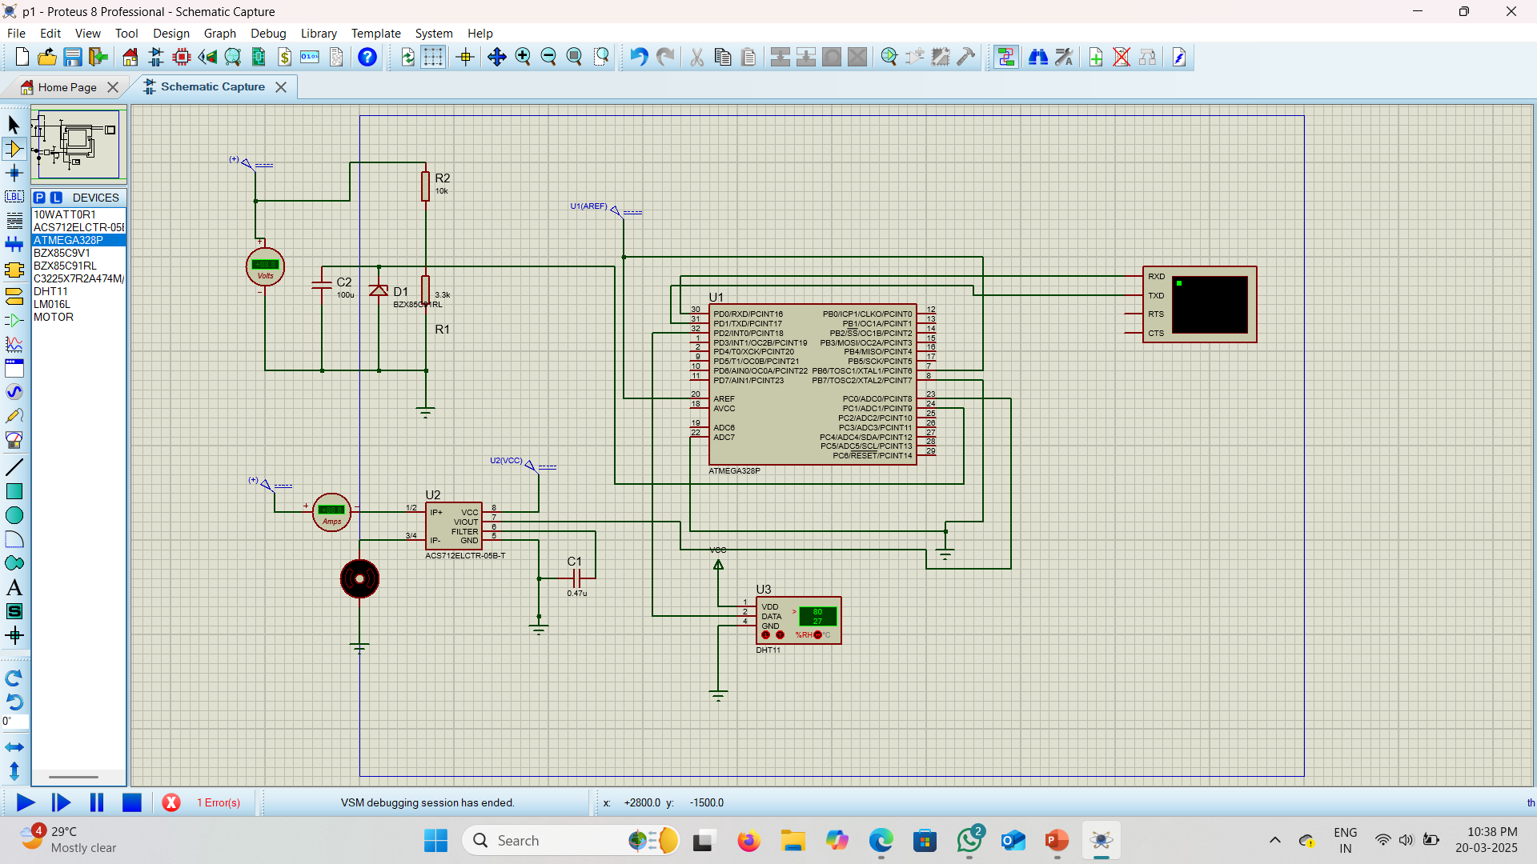
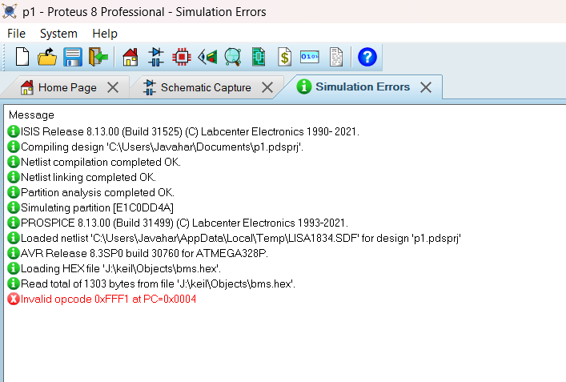
Verifying The Project Model Circuit Simulation In Proteus Software

Slide 12
MODULE 2: HARDWARE DEVELOPMENT AND TESTING
Module 2 - Overview:
The aim of this module is to build a Battery Management System (BMS) prototype that monitors essential battery parameters in real time and takes preventive safety actions when critical conditions are detected.
Microcontroller: The core of the design is the ARDUINO UNO, which uses the ATMEGA328 microcontroller to gather and process sensor data.
Sensors used:
Voltage Attenuator – Monitors For Over-voltage And Step Down The Voltage.
Current Attenuator – Monitors Charge/Discharge Currents.
Temperature Sensor (DS18B20) – Detects Overheating.
Flame Sensor – Detects Fire Or Combustion Threats.
IR Sensor – Detects Physical Bulging/Swelling In The Battery.
Wi-Fi Module (ESP8266): Enables Cloud-based Monitoring By Sending Data To An Iot Server In Real-time.
LCD Display (16x2): Displays Live Readings And Warnings Locally.

Slide 13
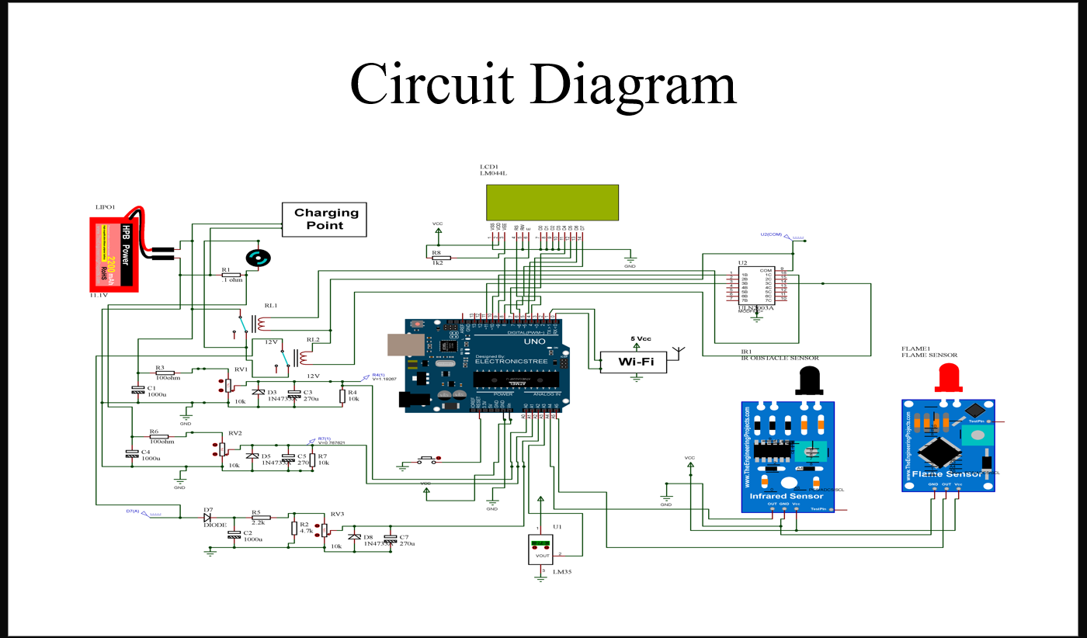
CIRCUIT DIAGRAM

Slide 14
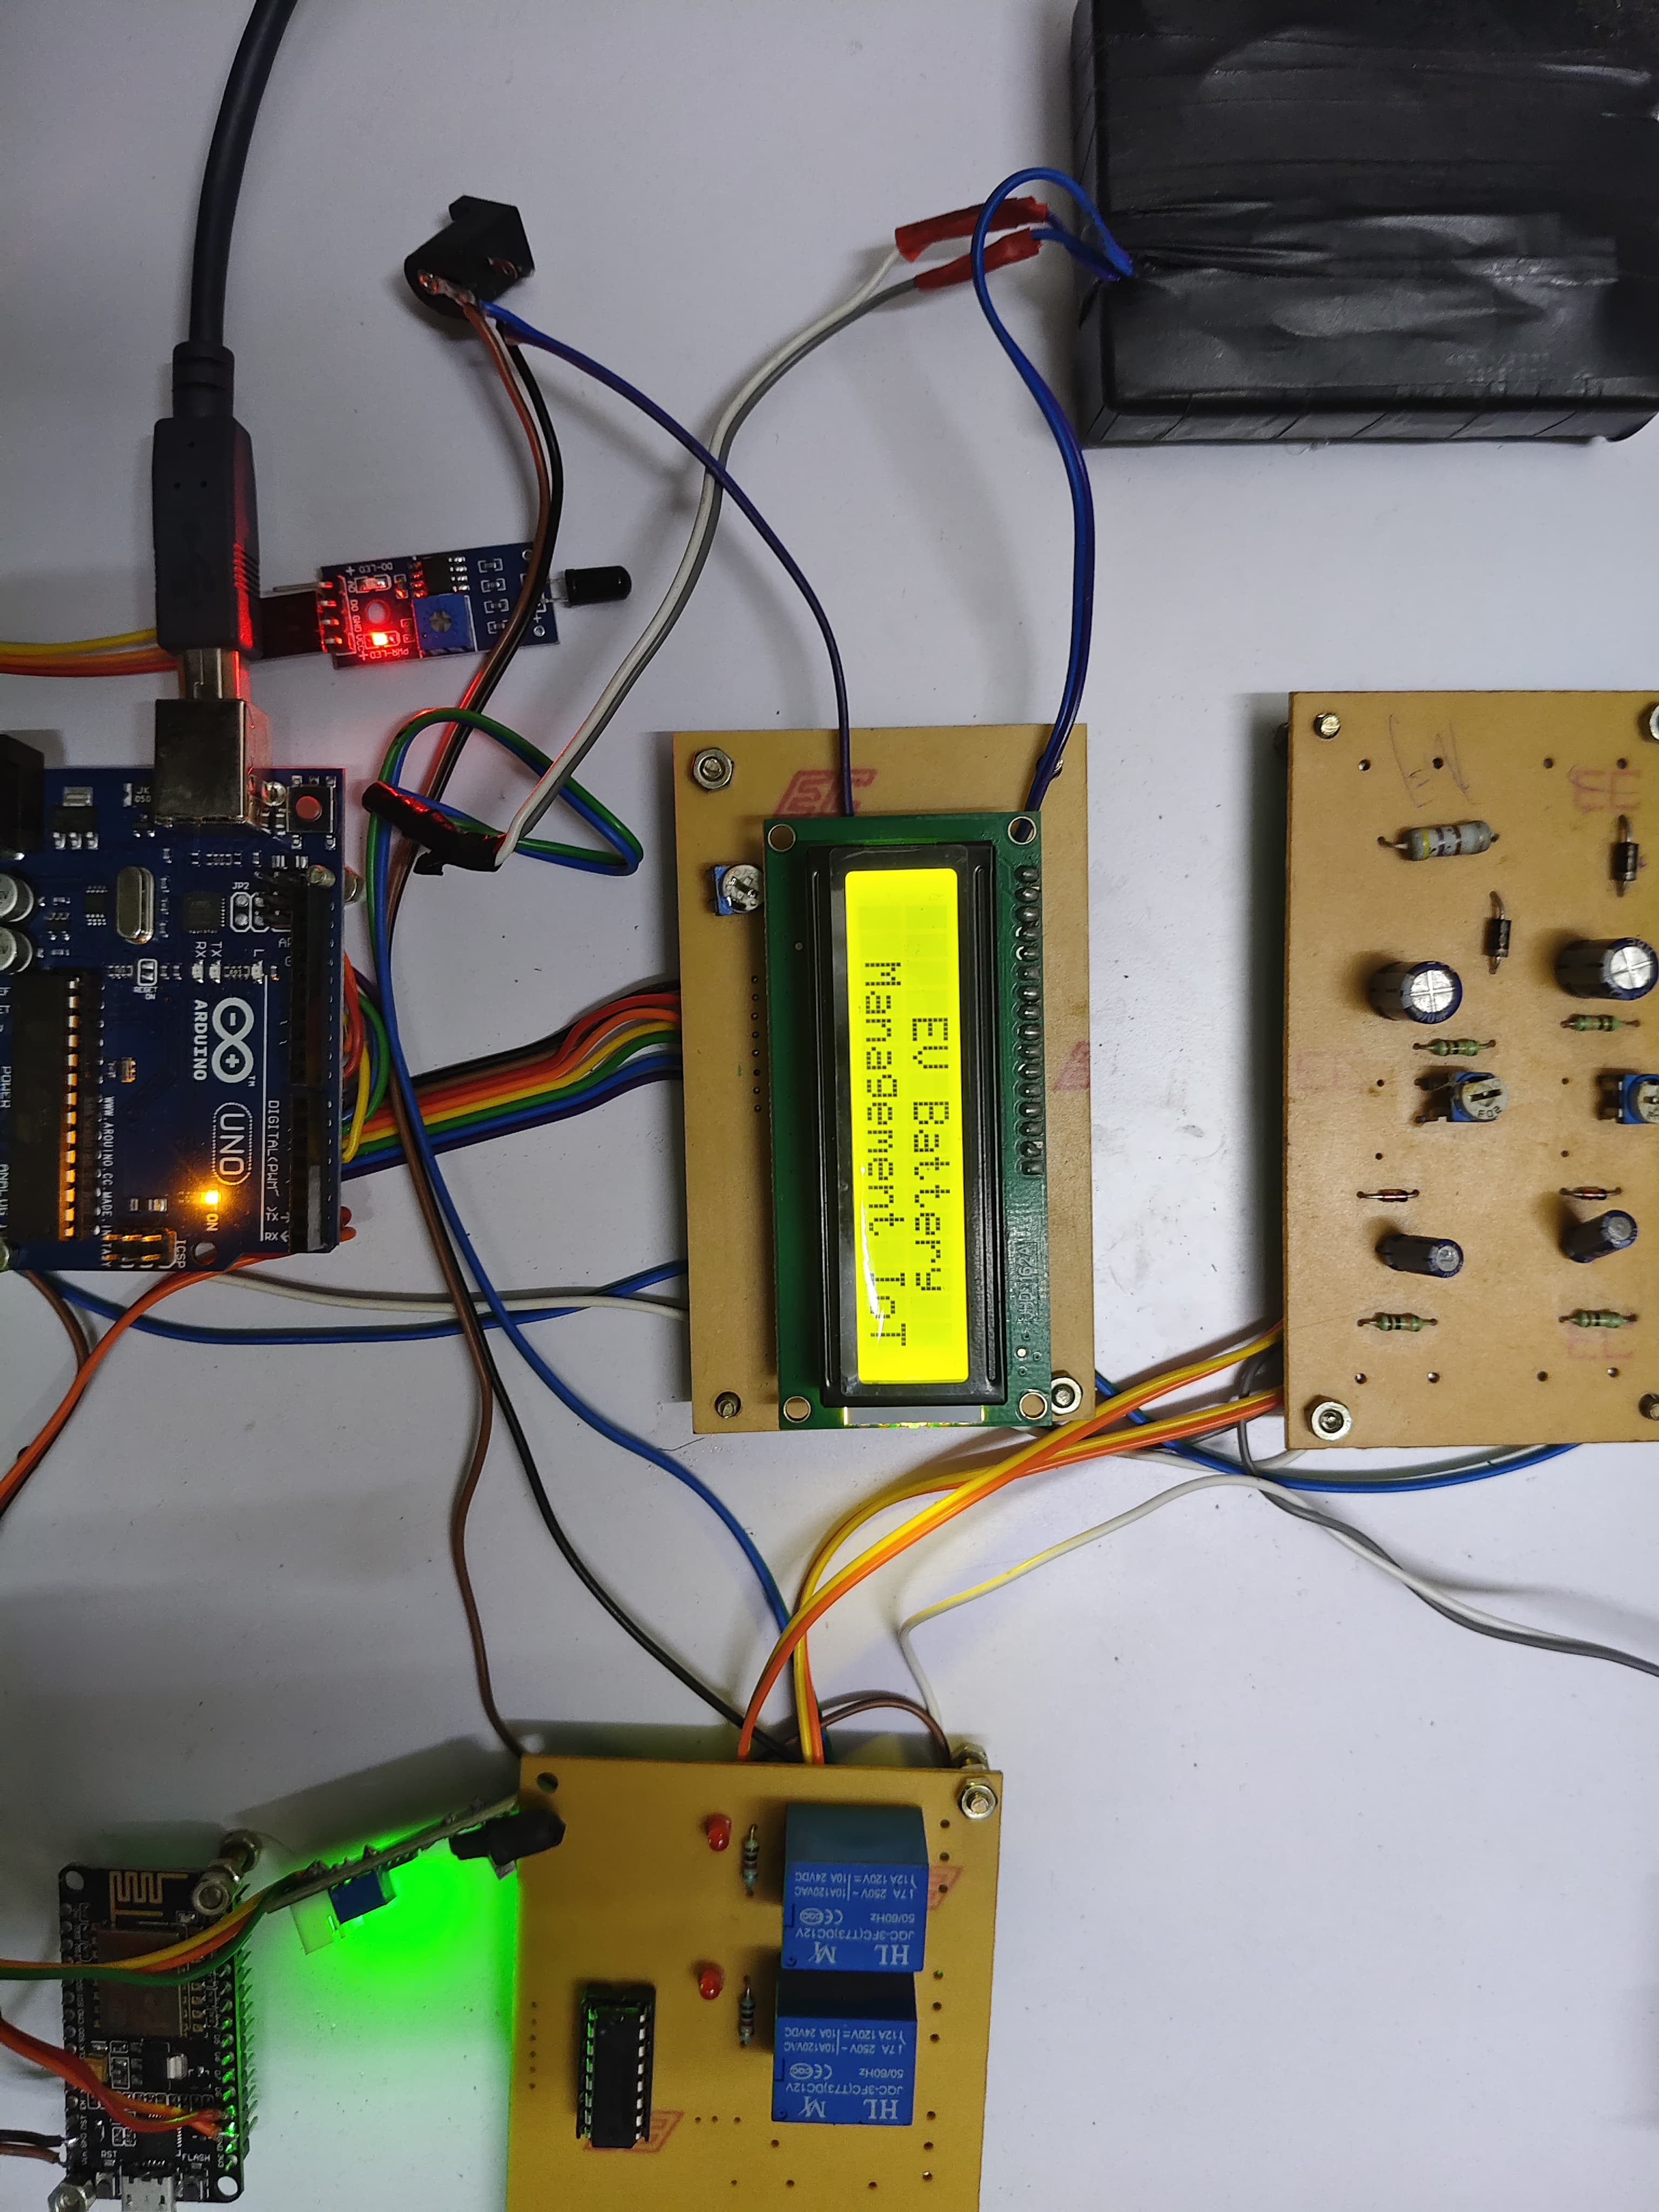
PROTOTYPE IMAGE
IOT Based Battery Management System

Slide 15
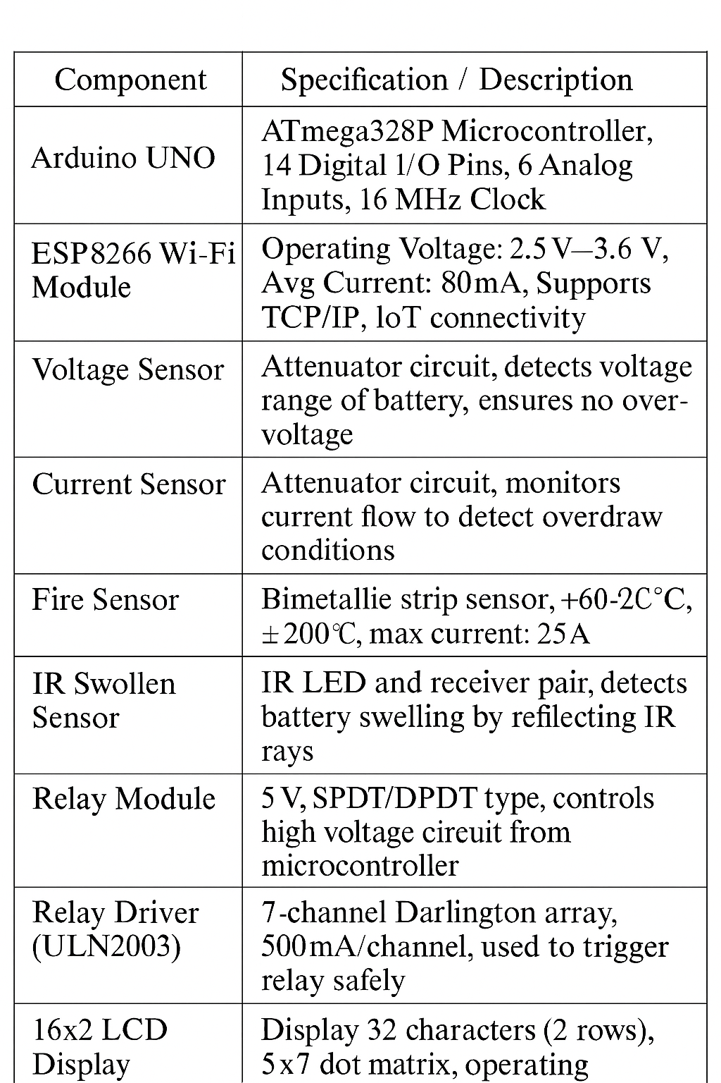
HARDWARE & SOFTWARE COMPONENT SPECIFICATIONS
Hardware | Software
Arduino UNO Microcontroller Current Sensor (Attenuator) Voltage Sensor (Attenuator) Driver Relay Wi-Fi Fire Sensor IR Sensor (Swollen sensor) Temperature Sensor Charger DC 12V Motor LCD | Arduino IDE, Embedded C, IoT Cloud Platform.

Slide 16
CIRCUIT DESCRIPTION: POWER SUPPLY: A Lipo Battery (11.1V) Is Used As The Primary Power Source. Power Is Stepped Down And Distributed To The Arduino, Sensors, And Modules. ARDUINO UNO: Acts As The Central Control Unit. Reads Data From Sensors And Controls Relays And The Wi-fi Module. SENSOR CONNECTIONS: DS18B20(Temperature Sensor) Is Connected To An Analog Pin Of Arduino. Flame Sensor And IR Sensor Are Connected To Digital Pins. Each Sensor Has Vcc, GND, And Signal Lines Connected Appropriately. LCD DISPLAY (16x2): Connected Via Parallel Data Lines (D0-D7) And Control Pins (RS, EN). Powered By 5V Vcc And GND From The Arduino. Displays Real-time Sensor Data And Warnings. RELAY MODULE: Controlled By A Digital Output Pin From The Arduino. Used To Disconnect The Battery Or Charger Under Unsafe Conditions (E.G., Overheat Or Flame Detection).

Slide 17
WI-FI MODULE (ESP8266): Powered With 5V Vcc And GND. TX And RX Pins Connected To Arduino’s Serial Pins For Data Communication. Sends Live Sensor Data To An Iot web Server. . CHARGING POINT: Connected To The Relay System. Allows Safe Battery Charging By Disconnecting Power In Abnormal Conditions. VOLTAGE ATTENUATOR : Built Using A Resistor Divider Circuit. Scales Down Battery Voltage (E.G., 11.1V) To <5V For Arduino Analog Input. CURRENT ATTENUATOR: Uses A Series Resistor To Generate A Voltage Drop Based On Current. Voltage Drop Is Proportional To Current Flow. Safe For Current Sensing And Overload Detection.

Slide 18
MODULE 3: IOT INTEGRATION AND MONITORING
Module 3 - Overview:
To Enable Real-time remote monitoring of EV Battery parameters by sending sensor data from the Arduino-based BMS System to an IOT Cloud Server using the ESP8266 Wi-fi Module.
BMS monitors key parameters:
Charging Voltage
Discharging Voltage
Discharging Current
Battery Temperature
IR Sensor (Swelling Detection)
In Module 3, This Sensor Data is transmitted to the Cloud Platform using the ESP8266 Module.

Slide 19
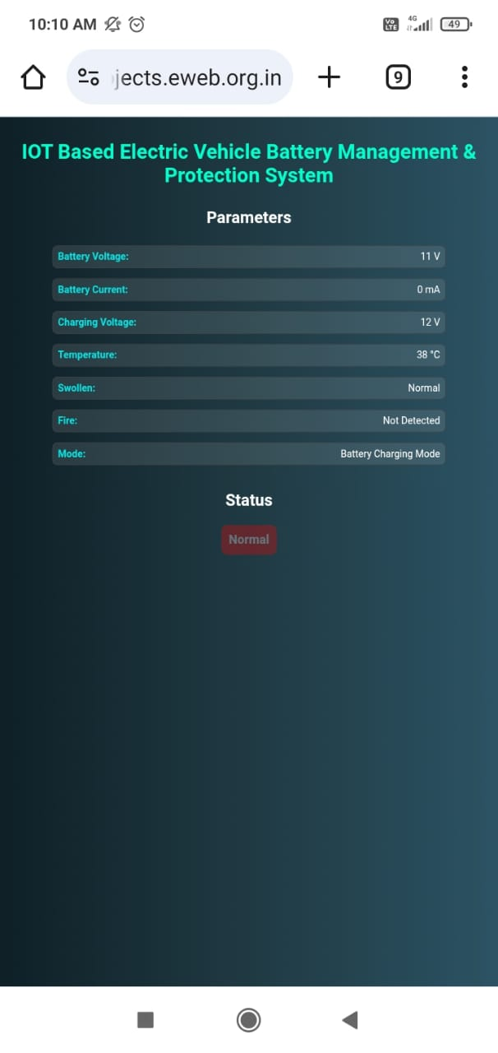
MODULE 3 IMPLEMENTATION
Component | Role
ESP8266 (NodeMCU or standalone) | Sends data over Wi-Fi to cloud
Arduino UNO | Gathers sensor data, transmits to ESP8266
IoT Platform | Cloud server
Sensors | Voltage, Current, DS18B20 (Temp), IR, Flame
Relay Module | Disconnects battery if faults are detected
The Web Dashboard of the battery status

Slide 20
EXPERIMENTAL RESULTS AND ANALYSIS
1. Sensor Integration and real-time monitoring (Module 1 & 2):
We implemented hardware-level monitoring for the following critical battery health parameters:
Voltage sensor (attenuated) – for overvoltage/undervoltage detection
Current sensor – to detect charging/discharging current
Temperature sensor (ds18b20) – to prevent overheating
Flame sensor – to detect any fire or combustion around the battery
IR sensor – to detect physical swelling or bulging, a sign of internal damage
Key Result:
The system correctly detected abnormal conditions and responded by activating a relay module to isolate the battery, preventing hazardous outcomes.

Slide 21
2. Control Logic and Display Feedback:
Arduino UNO (atmega328p) was used as the central controller.
It processed all sensor inputs in real-time and executed control logic based on predefined threshold values.
A 20x4 LCD display was integrated to show:
Voltage
Current
Temperature
Swelling
Alerts (e.g., “over voltage”, “swelling detected”)
Key Result:
Accurate, continuous updates on sensor data were displayed.
But the system have a delay to react at Abnormal Condition

Slide 22
3. IOT Cloud communication via ESP8266 (Module 3):
In the final phase, We implemented ESP8266-based wi-fi communication to send real-time battery data to a cloud platform .
The ESP8266 received data via serial communication from Arduino.
It connected to a Wi-Fi network and sent updates (Voltage, Current, Temperature, Bulging/Fire status) to the cloud.
The Cloud Dashboard visualized the data in status messages.
Key Result:
Remote monitoring was successfully achieved.
Users could access live battery health status on mobile or pc.
Alerts were triggered when sensor thresholds were breached.

Slide 23
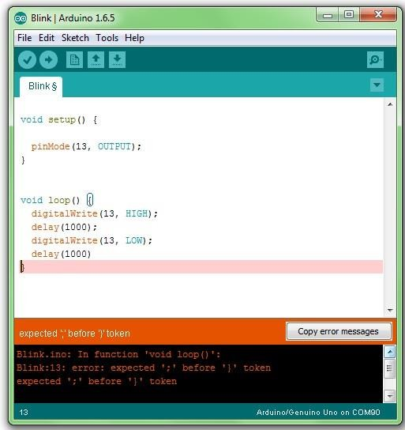
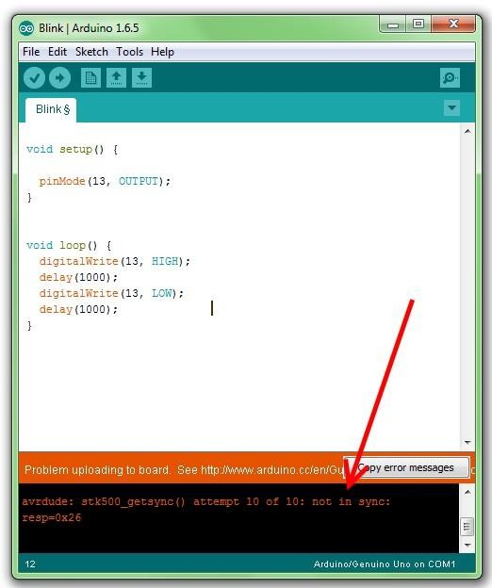
SOFTWARE IMPLEMENTATION
Basic syntax error in Arduino uno code.
Installation of USB Driver in Arduino IDE

Slide 24
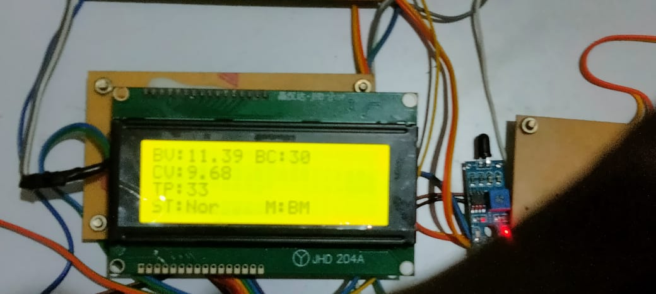
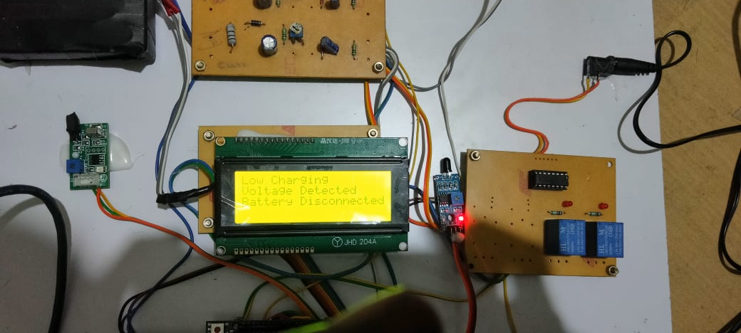
IMPLEMENTATION RESULTS
Low voltage Detected
Low voltage Battery Disconnected

Slide 25
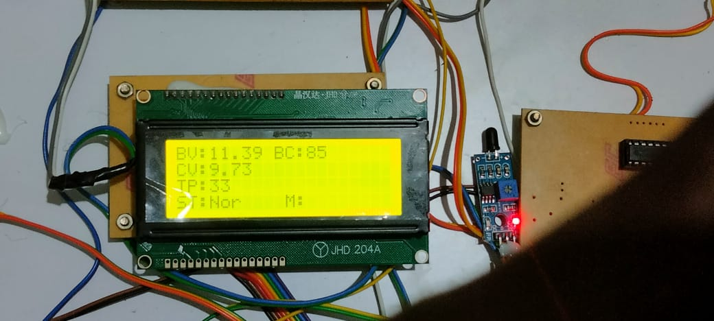
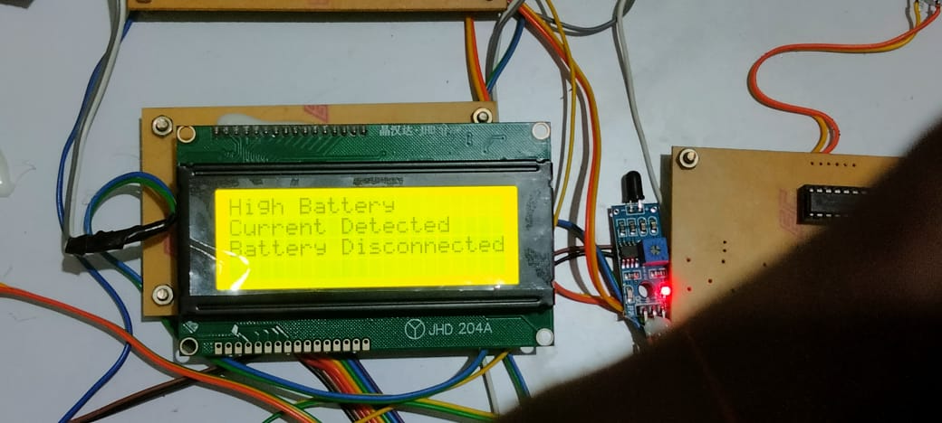
High Current Detected
High Current Battery Disconnected

Slide 26
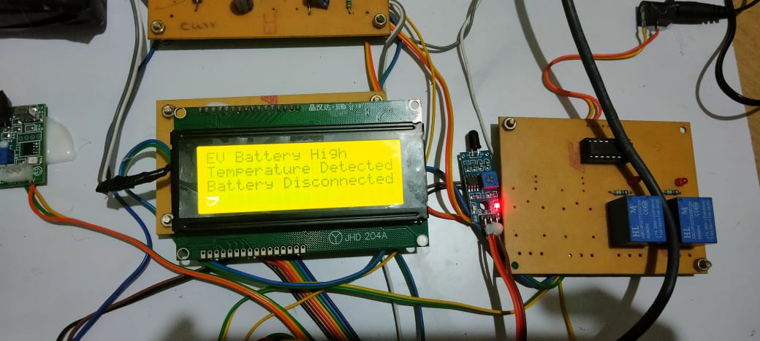
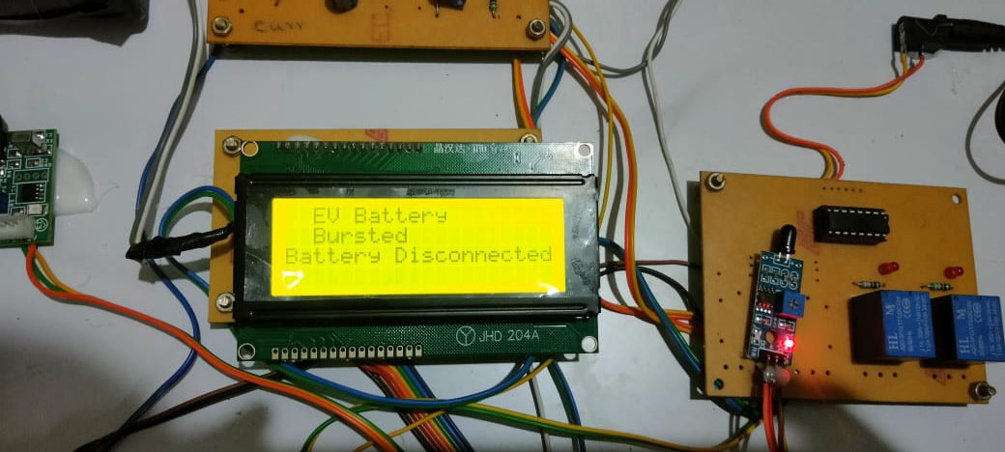
High Temperature Detected
Battery Bulge Detected

Slide 27
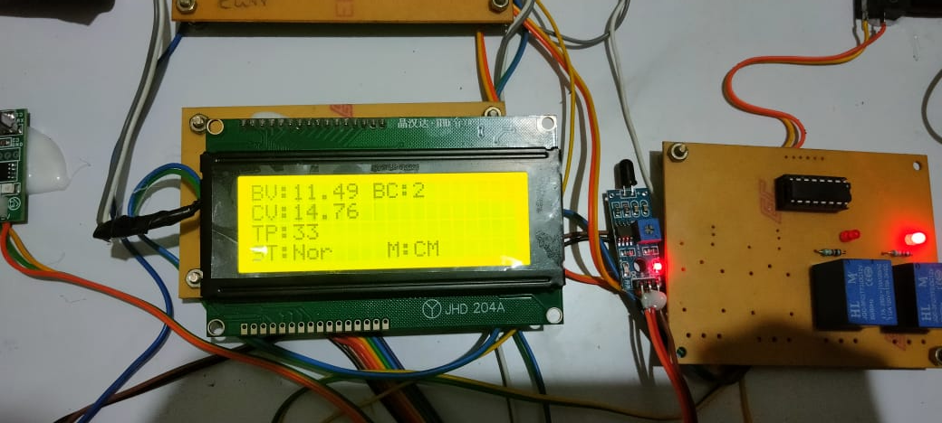
High Voltage Detected

Slide 28
CONCLUSION AND FUTURE SCOPE
Conclusion
Future Scope
We built a smart system that keeps track of the EV battery’s health in real time, helping users stay informed and safe.
It was able to catch issues like overheating, low voltage, or battery swelling early and take action before they became serious problems.
Overall, the project made battery management easier, safer, and more reliablegiving both users and technicians better control.
In the future, we can add machine learning to help the system learn from battery usage and predict problems before they happen.
We also plan to explore faster and wider-range wireless tech like 5G or LoRaWAN for better communication, especially in large vehicles or fleets.
Creating a user-friendly mobile app with better security features would make it even easier for users to get real-time updates and keep their data safe.

Slide 29
REFERENCES
S. Wu, Q. Yuan, Z. Yan, And Q. Xu, Analyzing Accident Injury Severity Via An Extreme Gradient Boosting (Xgboost) Model, J. Adv. Transp., Vol. 2021, Pp. 111, Sep. 2021.
D. Shin, B. Yoon, And S. Yoo, Compensation Method For Estimating The State Of Charge Of Li-polymer Batteries Using Multiple Long Short-term Memorynetworksbased Ontheextended Kalman Lter, Energies, Vol. 14, No. 2, P. 349, Jan. 2021.
J. Qiao, S. Wang, C. Yu, W. Shi, And C. Fernandez, A Novel Bias Compensation Recursive Least Square-multiple Weighted Dual Extended Kalman Ltering Method For Accurate State-of-charge And State-of-health Co-estimation Of Lithium-ion Batteries, Int. J. Circuit Theory Appl., Vol. 49, No. 11, Pp. 38793893, Nov. 2021.
J. Tian, R. Xiong, J. Lu, C. Chen, And W. Shen, Battery State-of-charge Estimation Amid Dynamic Usage With Physics-informed Deep Learning, Energy Storage Mater., Vol. 50, Pp. 718729, Sep. 2022.
A. Varshney, A. Singh, A. A. Pradeep, A. Joseph, And P. Gopakumar, Monitoring State Of Health And State Of Charge Of Lithium-ion Batteries Usingmachinelearningtechniques, Inproc.Ieee5thint.Conf.Condition Assessment Techn. Electr. Syst. (CATCON), Dec. 2021, Pp. 022027.

Slide 30
THANK YOU !!!

